Slide 1
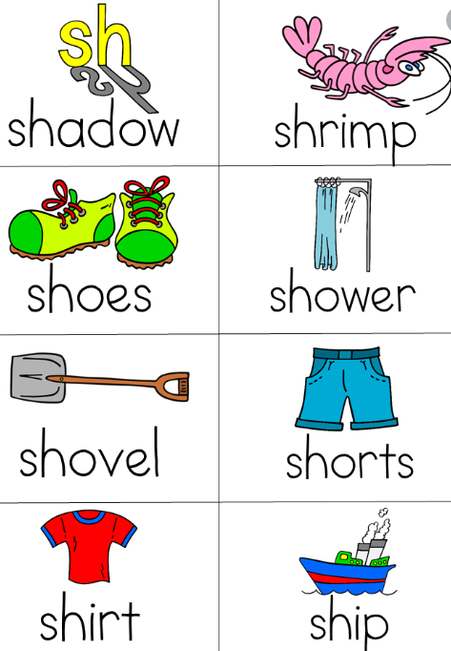
‘sh’ sound

Slide 2
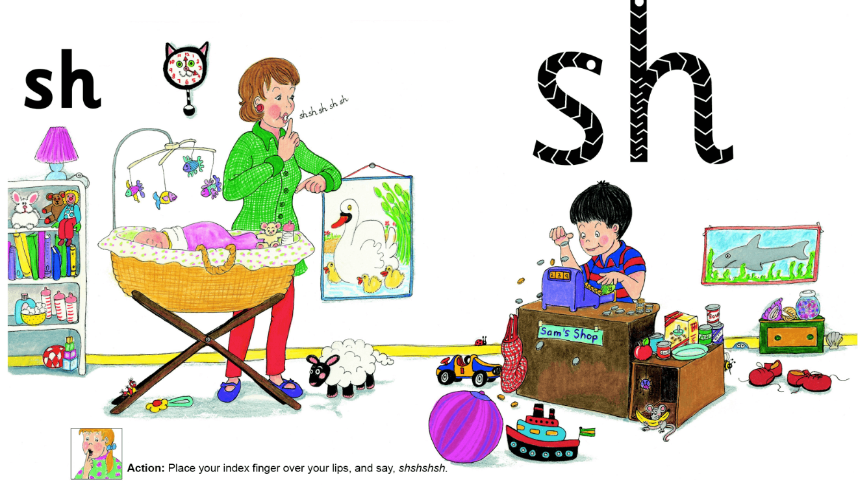
Can you find some words containing the ‘sh’ sound?
Click on the speaker to hear the song.

Slide 3
‘sh’ song words

Slide 4
Here are some ‘sh’ words for you to read.

